Slide 1
Container Orchestration –Kubernetes(k8s)

Slide 2
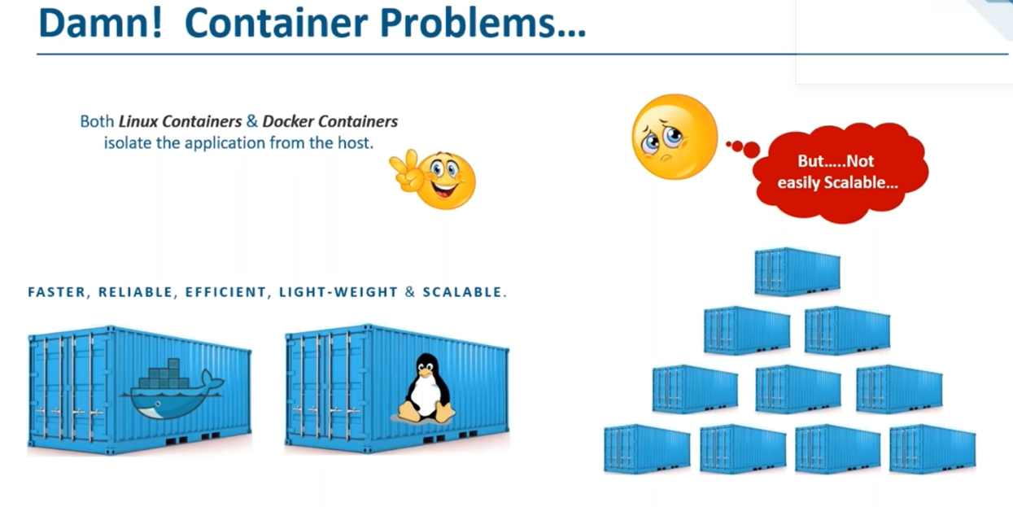
Containers Problems

Slide 3
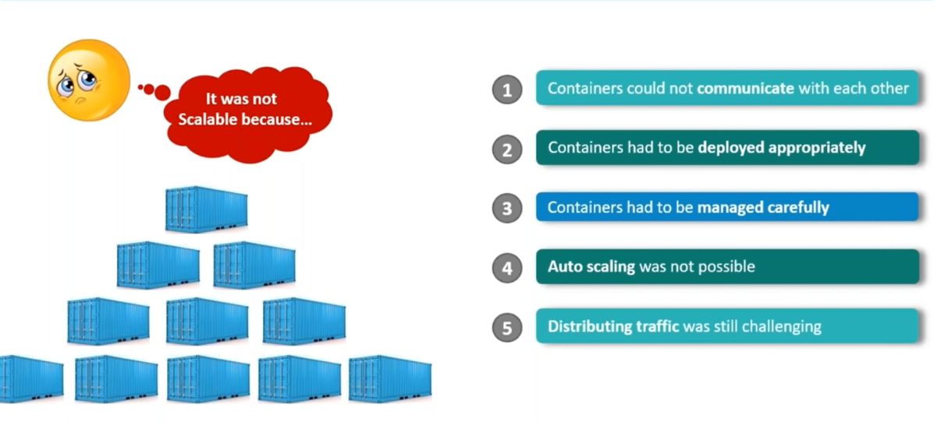
Problems with Containers

Slide 4
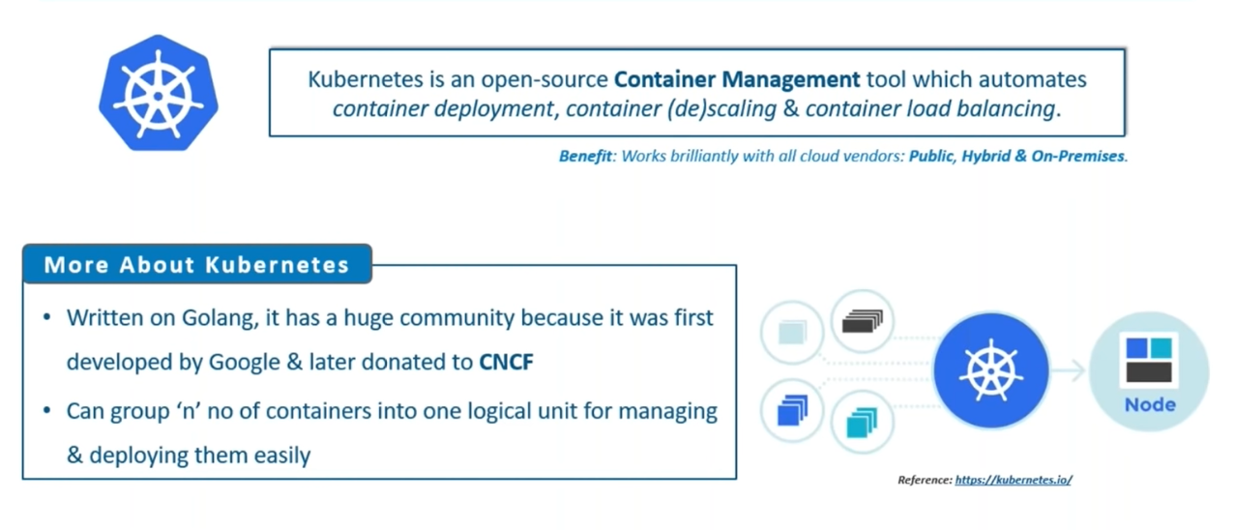
Kubernetes

Slide 5
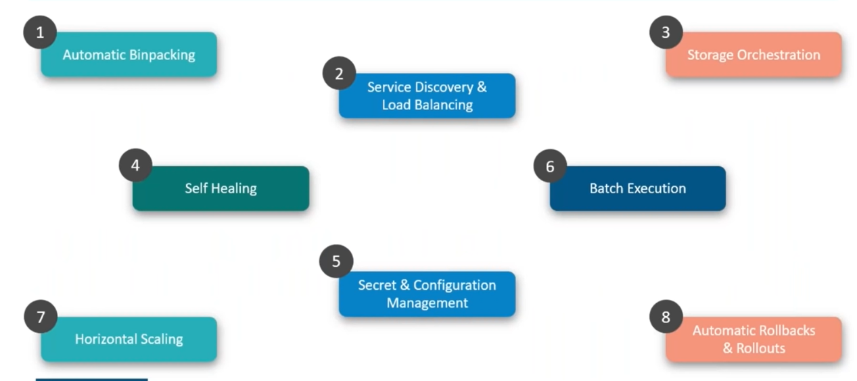
Features of Kubernetes

Slide 6
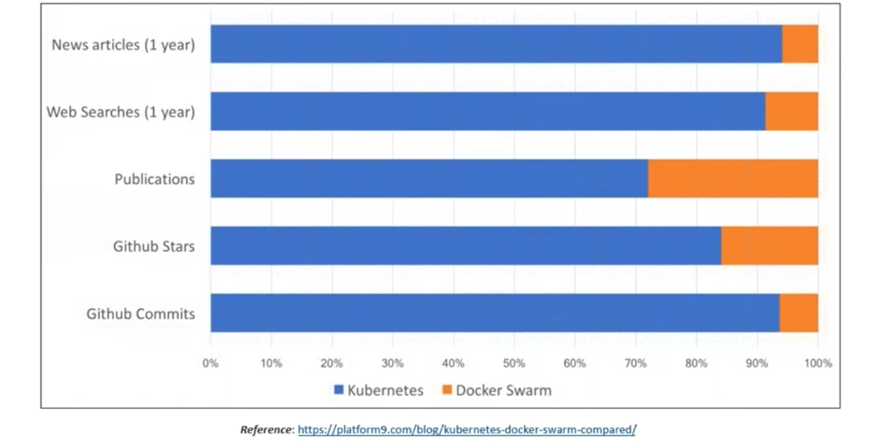
Why Kubernetes ?

Slide 7
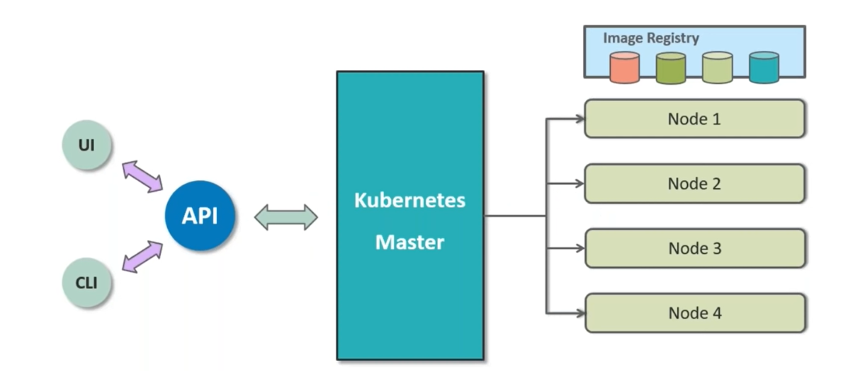
Kubernetes Architecture

Slide 8
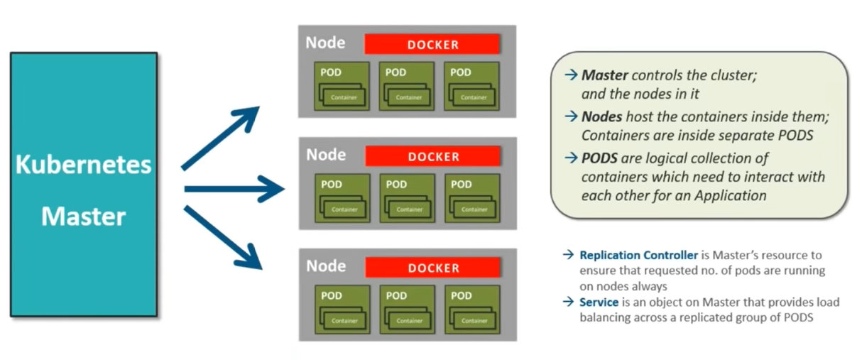
Kubernetes Architecture and Working

Slide 9
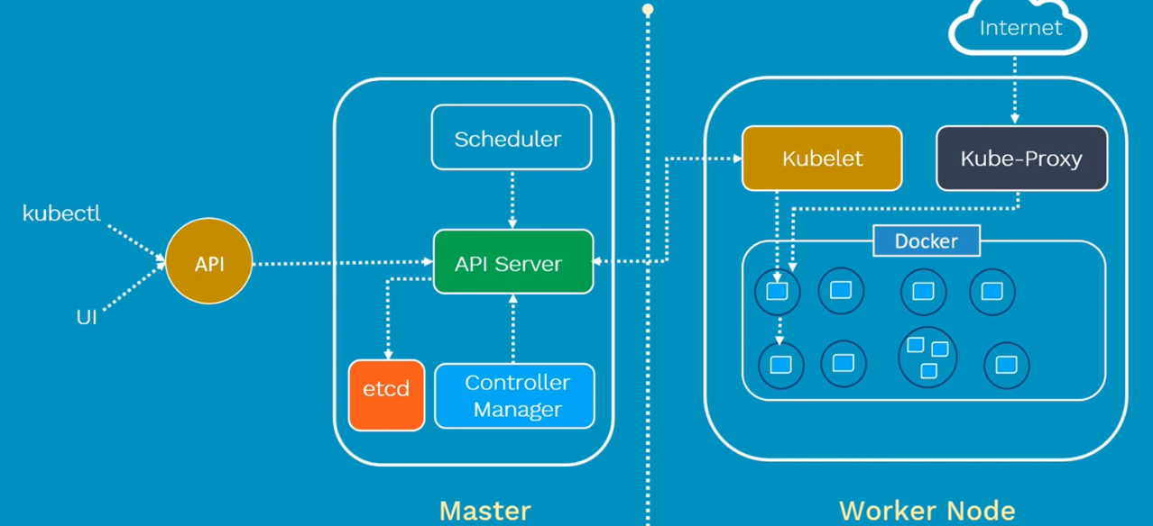
Kubernetes Architecture and Components

Slide 10
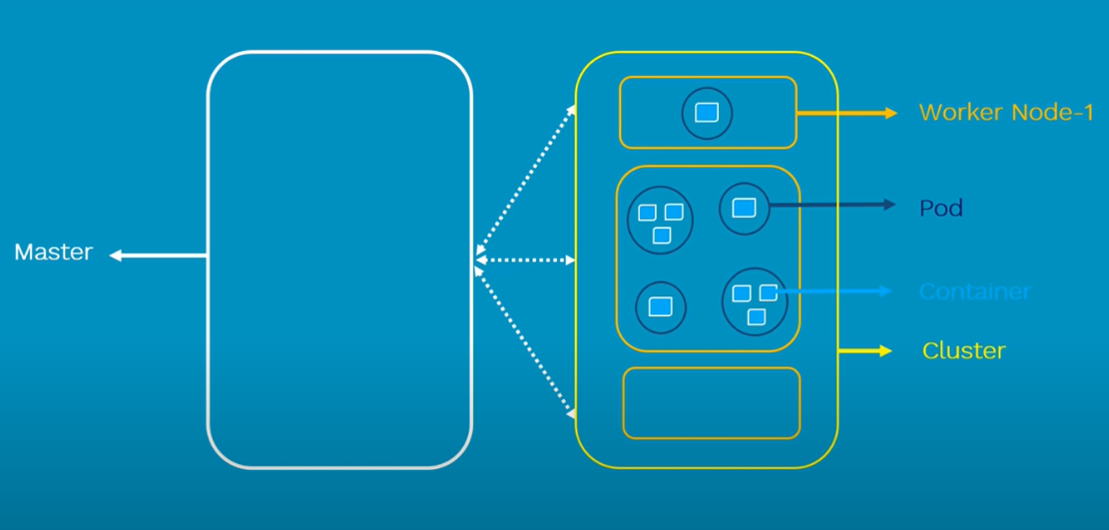
Kubernetes Architecture and Components

Slide 11
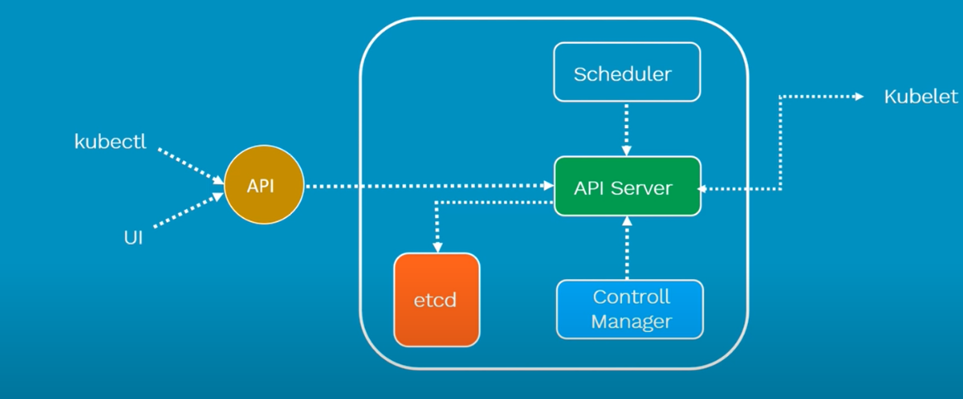
Kubernetes Architecture and Components

Slide 12
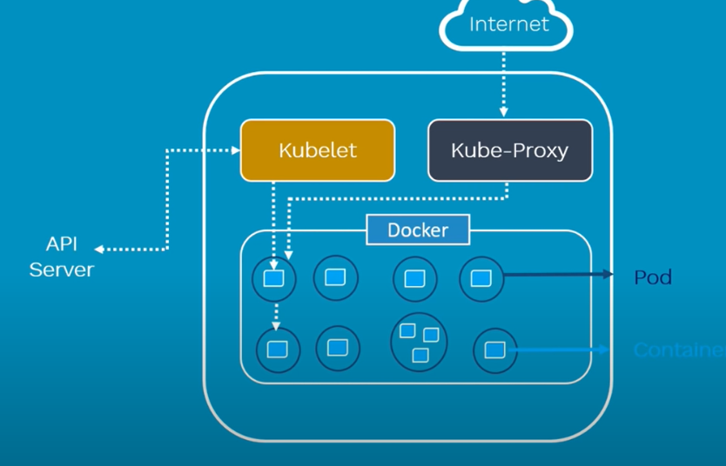
Kubernetes Architecture and Components

Slide 13
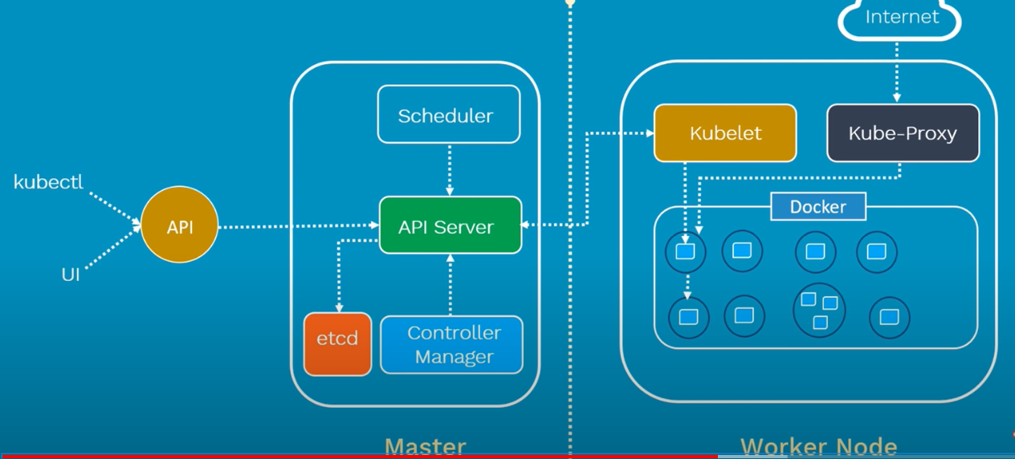
Kubernetes Architecture and Components

Slide 14
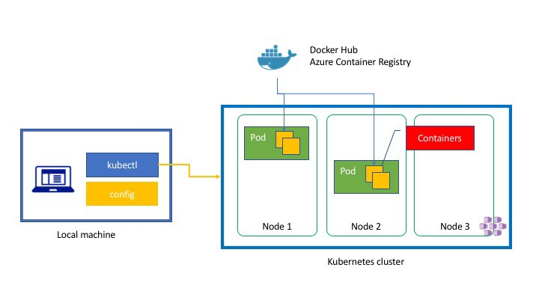
Kubernetes Container Deployment

Slide 15
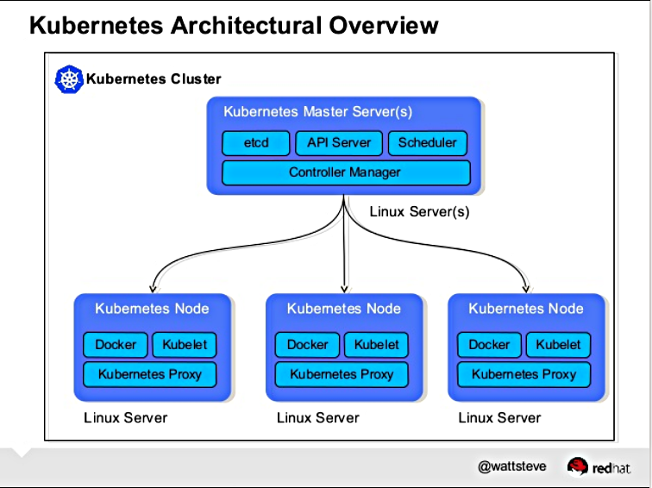
Kubernetes Architecture

Slide 16
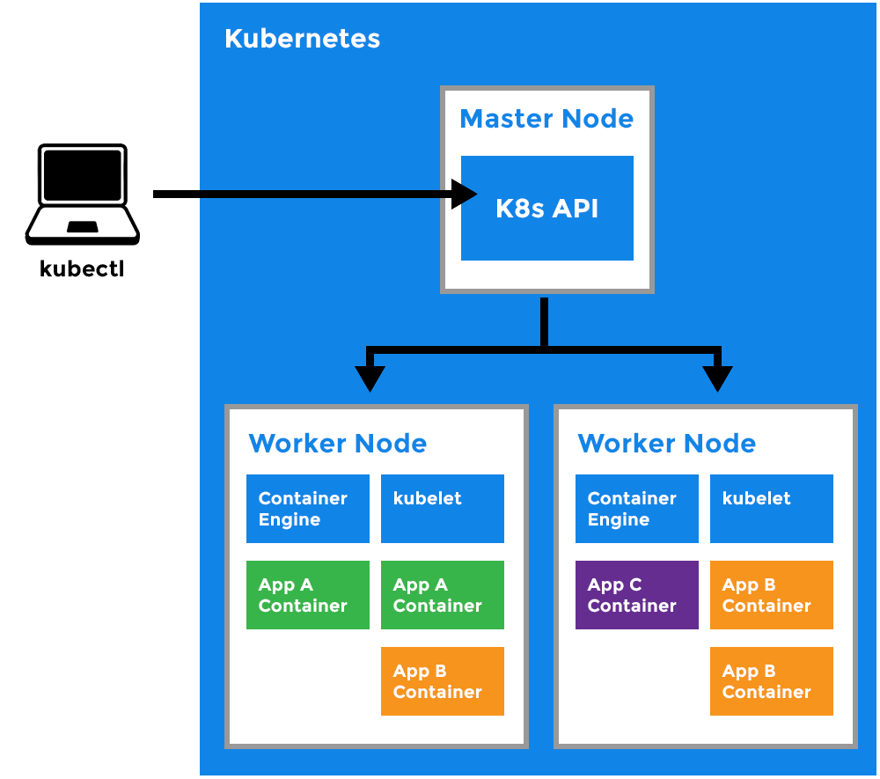
Kubernetes Working

Slide 17
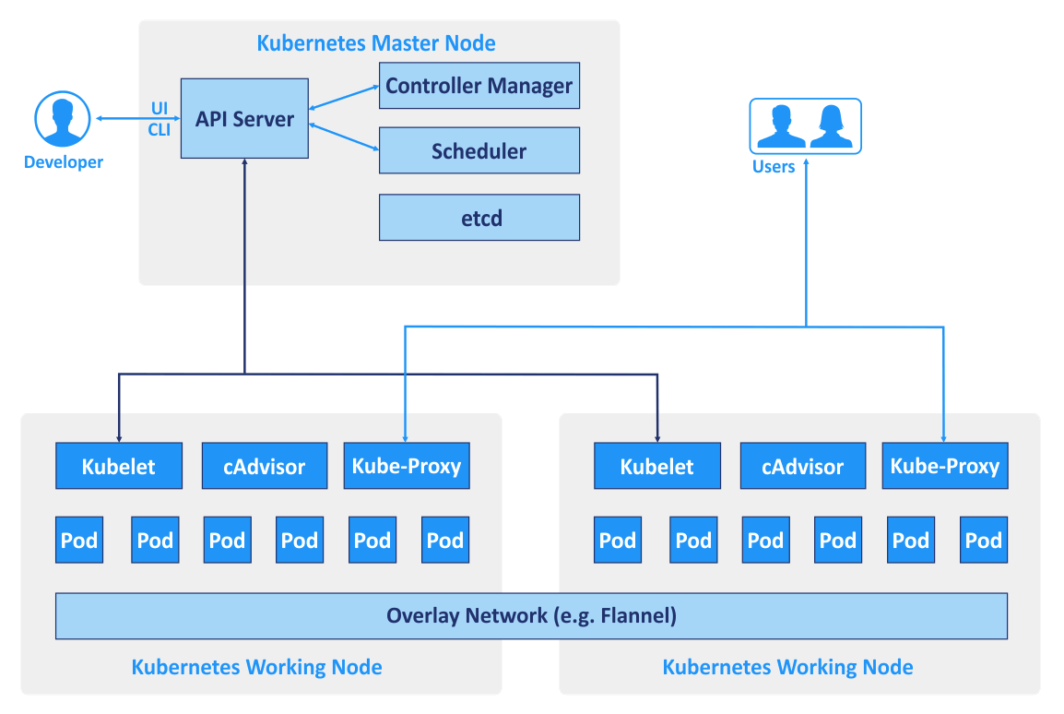
Kubernetes Pod and Network

Slide 18
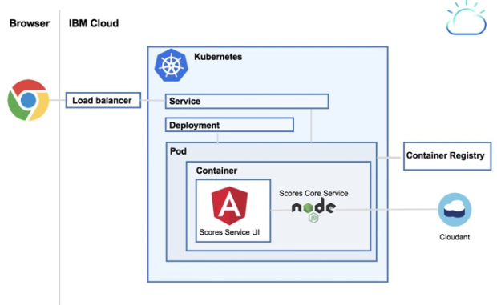
Kubernetes Container Deployment

Slide 19
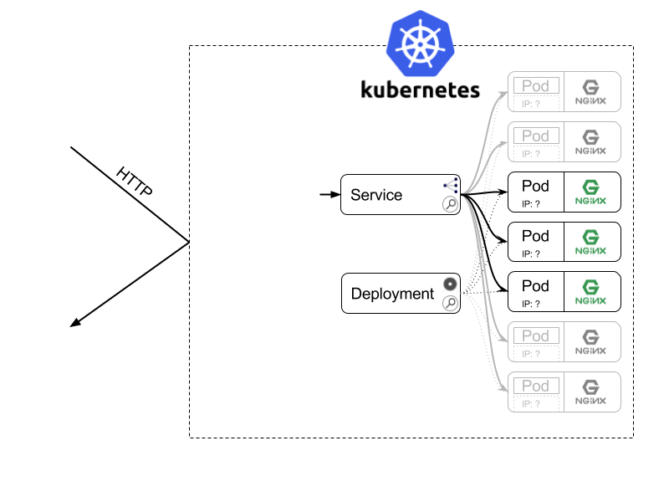
Kubernetes Service and Deployments

